Slide 1
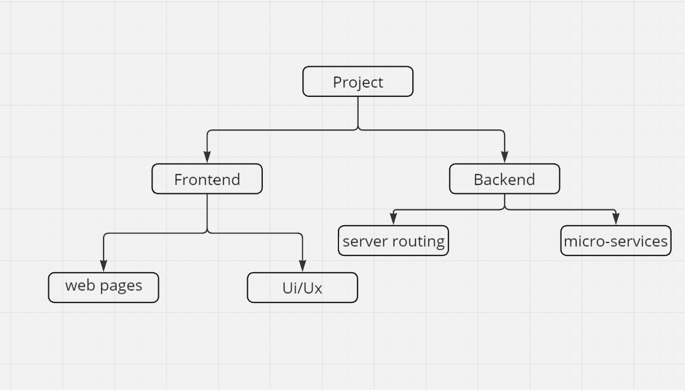
UI/Ux -- harsh, sid, Soumya
Webpages – harsh, sid, Soumya
Basic needs – signup page
2. Page for ekyc
3. Presonal dashboard for the user
4. Sos alarm and notifications
5. Basic form to survey the condition the user is in
Server routing – Anirud
1. make login and signup pages working linking it with database
Rest services will be handed by us

Slide 2
Project Structure
Data Collection Module
Collect video feeds from CCTV cameras, surveillance footage, or other data sources
Preprocess video data for object detection and analysis
Object Detection Module
Apply object detection algorithms (e.g., YOLO, SSD) to identify individuals in the video feed
Extract bounding box coordinates and other relevant features
Gender Classification Module
Use machine learning models (e.g., CNN, SVM) to classify detected individuals as male or female
Train models on a labeled dataset of images or video frames
Anomaly Detection Module
Implement algorithms (e.g., One-class SVM, Local Outlier Factor) to identify unusual patterns, such as a lone woman at night
Analyze video data and detect anomalies in real-time
Alert Generation Module
Develop a system to generate alerts and notifications to law enforcement or emergency services when anomalies are detected
Integrate with emergency services, such as police dispatch systems
Data Analysis Module
Utilize data visualization and statistical analysis to identify trends, hotspots, and areas of concern
Provide insights for strategic planning and city safety initiatives

Slide 3
System Architecture
Frontend
User interface for system administrators and law enforcement to monitor and respond to alerts
Real-time video feed display with bounding boxes and alerts
Backend
Data collection and processing module
Object detection and gender classification module
Anomaly detection and alert generation module
Data analysis and visualization module
Database
Store video data, object detection results, and alert information
Utilize a database management system (e.g., MySQL, MongoDB)
Technical Requirements
Programming Languages
Python for data analysis, machine learning, and backend development
JavaScript for frontend development.
Libraries and Frameworks
OpenCV for computer vision tasks.
TensorFlow or PyTorch for machine learning tasks.
scikit-learn for data analysis and visualization.
Flask or Django for backend development.
React or Angular for frontend development.

Slide 4
Implementation Strategy:
Data Collection and Preprocessing:
Gather a dataset containing images and videos of public spaces with labeled genders, gestures, and safety scenarios.
Preprocess the data to train detection and classification models.
Model Development:
Train deep learning models for person detection, gender classification, and gesture recognition.
Develop an anomaly detection model to identify unusual patterns and potential threats.
System Integration:
Integrate models into a real-time surveillance system, ensuring low latency and high accuracy.
Develop dashboards for real-time monitoring and data analytics.
Testing and Validation:
Test the system in various public spaces, validate the accuracy of detection, and refine models based on feedback.
Ensure the system minimizes false positives and negatives to avoid unnecessary alarms.
Linking with frontend and backend

